Slide 1
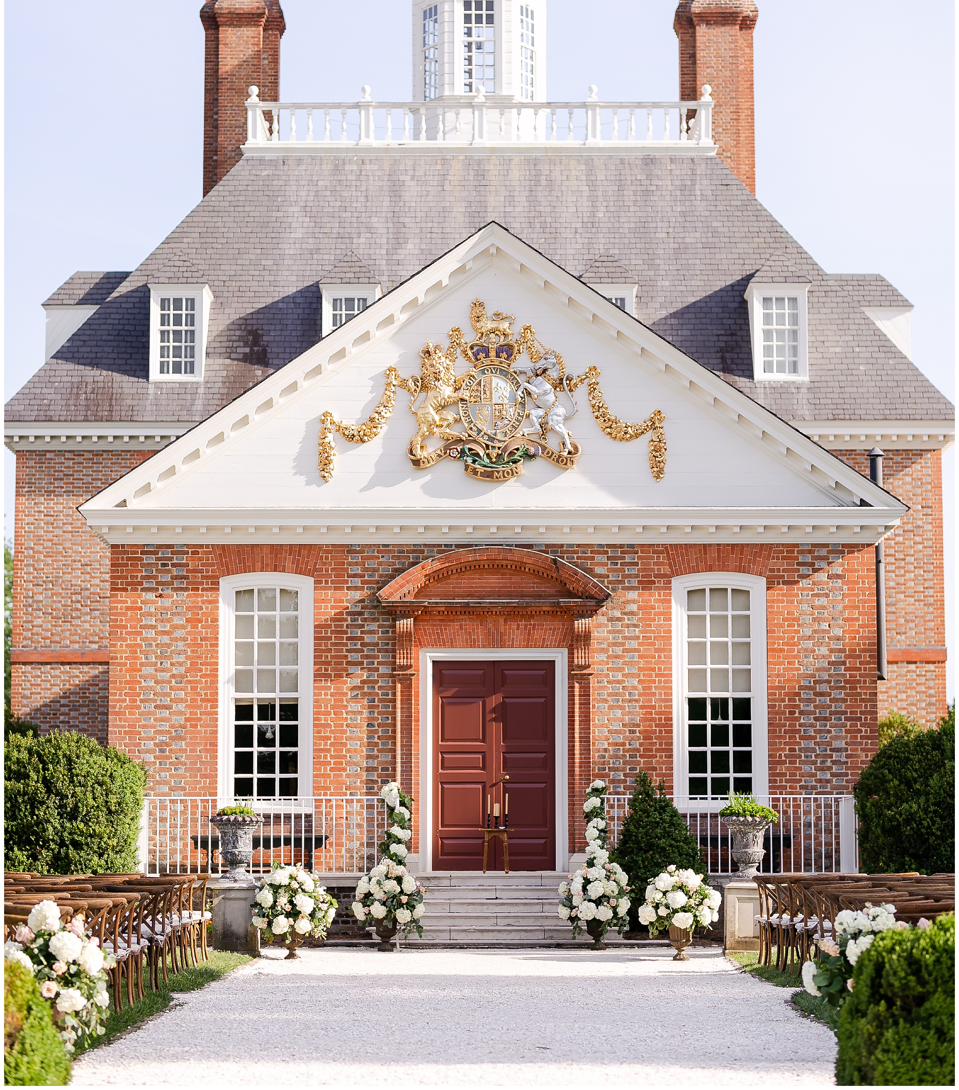
THE GOVERNOR’S PALACE:
ARCHITECTURE AND INTERIORS:
The Significance of Historic Preservation & Reconstruction for the Next Generation
PRESENTER: Sarah K. Lemley
PROGRAM OF STUDY: Family and Consumer Sciences-Interior Design
SUBTYPE: Textual or Investigative
(Luke & Ashley Photography, 2019)

Slide 2
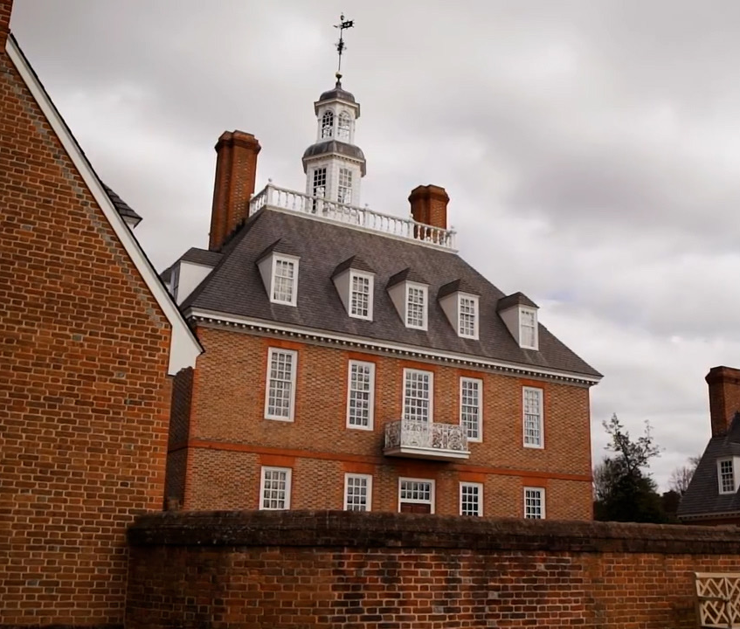
BACKGROUND & OVERVIEW
What is the Governor’s Palace?
  A once-functioning government building completed in 18th century America in Williamsburg, Virginia
  Originally constructed in 1772 & burned down in 1781
  Reconstructed in 1934 based on archeological investigations
  Research on furnishings & details continue to this day
(Wenger, 1997) ; (Hudgins, 1992)

Slide 3
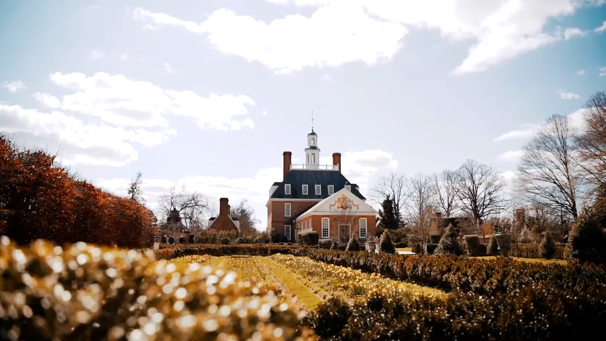
AIM OF RESEARCH
To examine how the reconstruction of the Governor’s Palace displays the importance of historical preservation, architecture, and history preserved for the next generation
To understand historic architecture and interior design of the time period through examining original textual construction documents
To gather insight on how the past can shape future reconstruction efforts based on archeological investigations

Slide 4
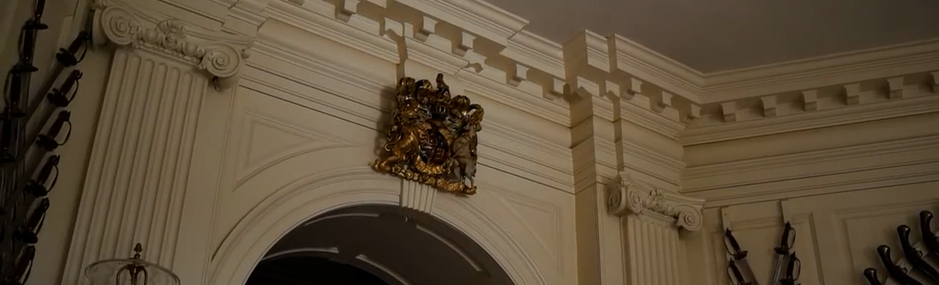
HISTORIC PRESERVATION &
THE NEXT GENERATION
What is Historic Preservation?
“Historic preservation is a conversation with our past about our future.”
History shows us events & places to be proud of. It also reminds us of painful or uncomfortable moments, too.
Observation of past successes and failures improves present-day architecture and design.
(National Park Service, 2020)

Slide 5
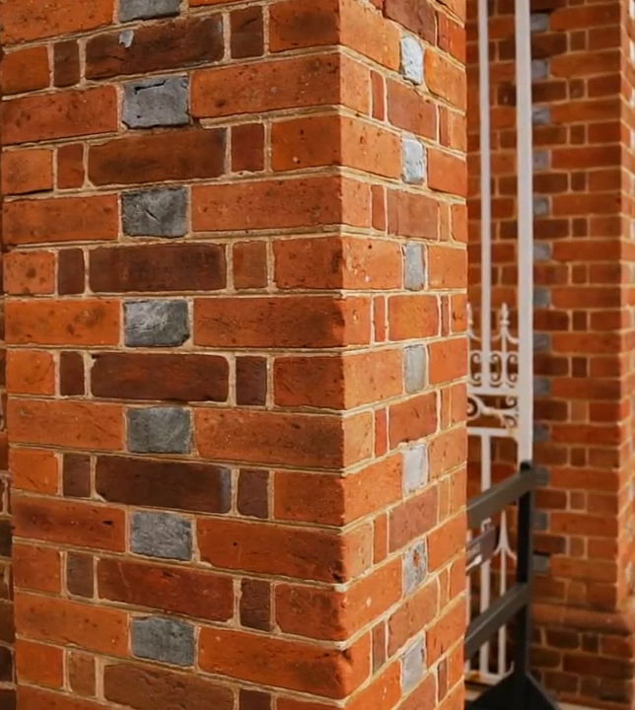
SOURCES OF KNOWLEDGE: HISTORICAL RECORDS
Where does our present-day knowledge of the Governor’s Palace come from?
  Thomas Jefferson’s measured drawing of the plan
  The Bodleian Plate: A copper engraving found in 1930 in the Oxford University archives
  The excavated original foundations featuring “wall footings, pourings, and building fragments”
  Governor Botetourt’s 1770 itemized list of the estate inventory
  (The Colonial Williamsburg Foundation Library & Maxwell, 1954)

Slide 6
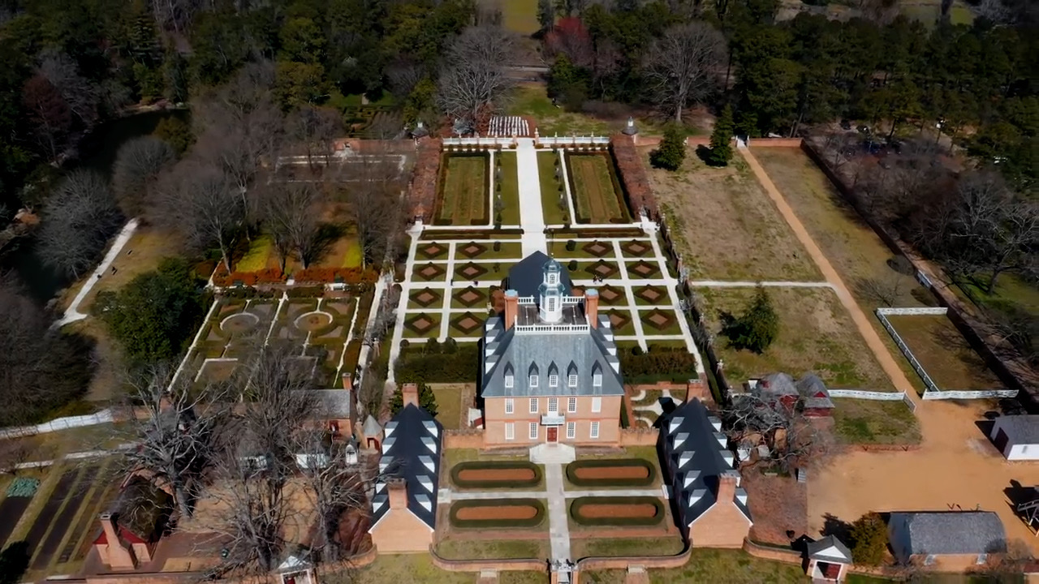

Slide 7
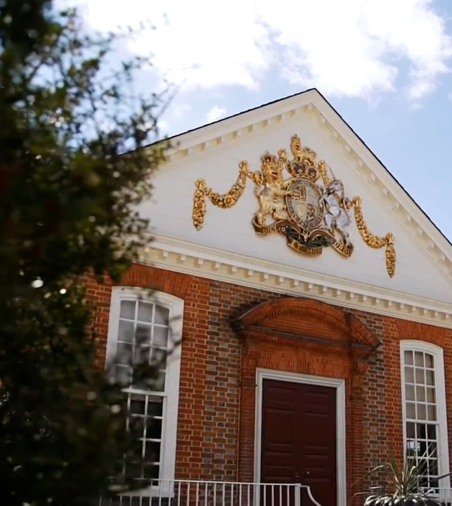
GEOGRAPHICAL IMPORTANCE ON A LARGER SCALE
Location: Historic Triangle of Virginia: the place of America’s foundation as a nation
Rich with historical evidence, information, and insight on the lives of early Americans
Beginnings: a nation founded on Christian principles and ethics

Slide 8
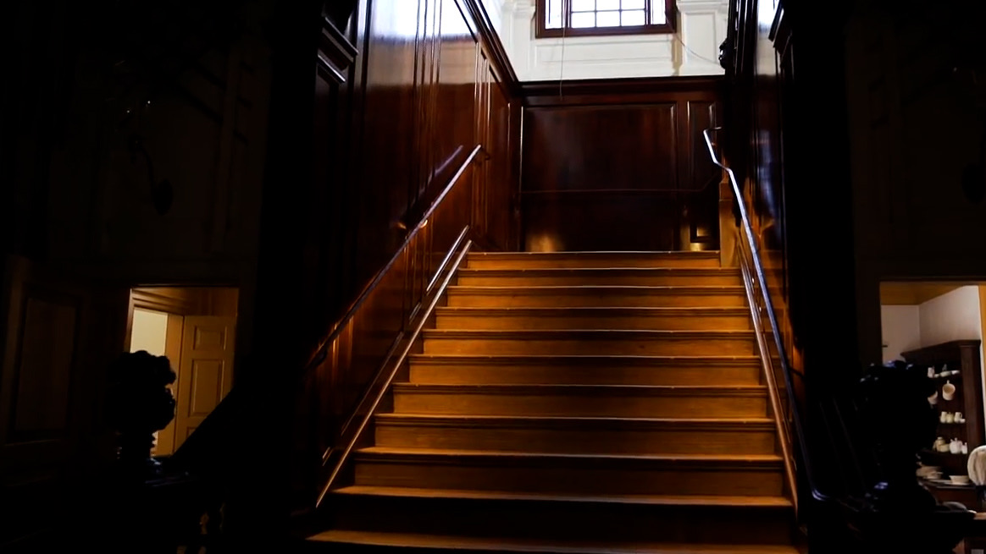
BIBLICAL CONNECTION
Physical reconstruction in relationship to Spiritual reconstruction
New buildings from archeological ruins: old life to new creation
“They shall build up the ancient ruins; they shall raise up the former devastations; they shall repair the ruined cities, the devastations of many generations” (Isaiah 61:4).

Slide 9
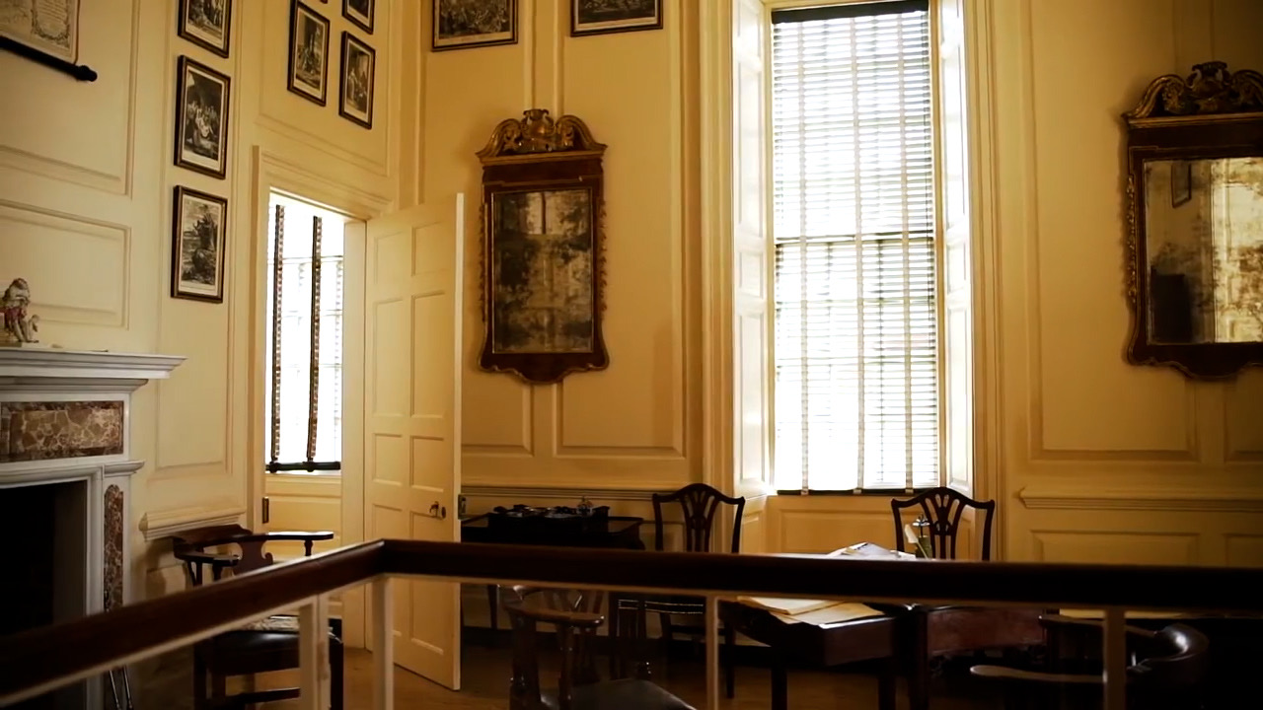
A CHRISTIAN WORLDVIEW OF ARCHITECTURE
Highlights previously unobserved connections between created works and the Creator, the Master Builder Himself
Displays the importance of learning from the past in looking forward to the future
Joshua 4 - Remembrance of God’s faithfulness through built structures
Ezra & Nehemiah: Architecture as a way of remembrance and community unification

Slide 10
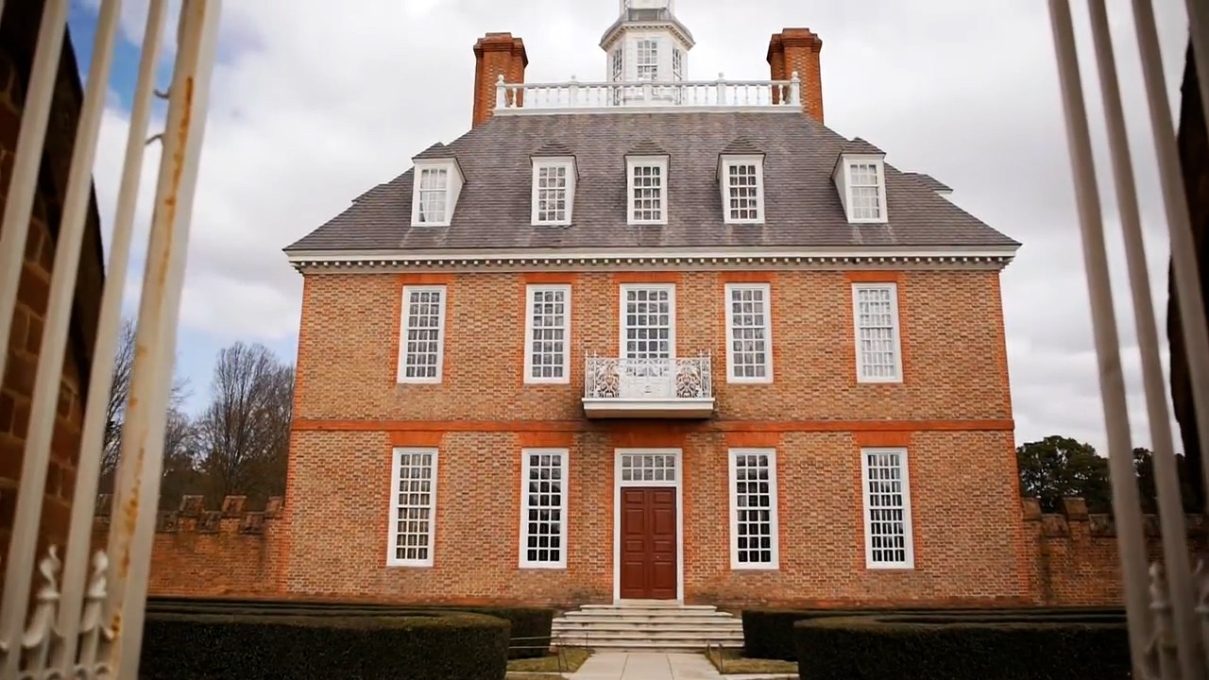
THE GOVERNOR’S PALACE
A standing example: accurate historical reproduction of Colonial architecture
A connection to the past: life, style, and design from the eighteenth century
A window to the future: preserving history for generations to come

Slide 11
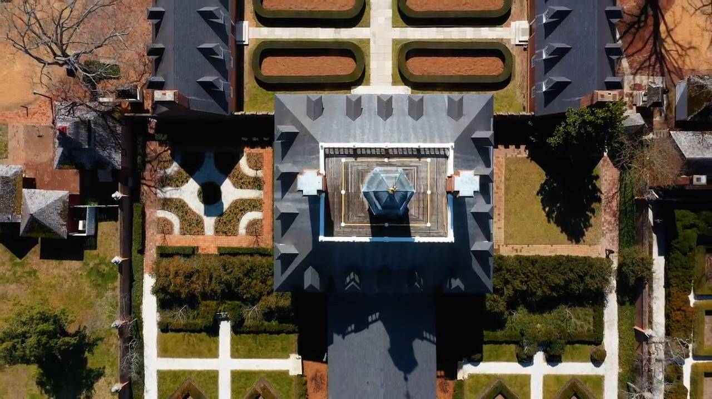

Slide 12
REFERENCES
Luke & Ashley Photography. (2019, August 6). Governor’s Palace Wedding [Photograph]. https://lukeandashley.com/governors-palace-wedding/
National Park Service. (2020, June 22). What is Historic Preservation? - Historic Preservation (U.S. National Park Service). https://www.nps.gov/subjects/historicpreservation/what-is-historic-preservation.htm
The Colonial Williamsburg Foundation Library, & Maxwell, W. (1954, November). Governor’s Palace Report, Block 20 Building 3A: Palace Manual (Colonial Williamsburg Foundation Library Research Report Series-1463). The Colonial Williamsburg Foundation Library. https://research.colonialwilliamsburg.org/DigitalLibrary/view/index.cfm?doc=ResearchReports\RR1463.xml&highlight=Governor%27s%20Palace
Video Content Adapted From:
Carson, B. (1987). The Governor's Palace: The Williamsburg Residence of Virginia's Royal Governor. Colonial Williamsburg.
Colonial Williamsburg Foundation Library. (1994). Governor's Palace Architectural Report, Block 20 Building 3A. Architecture of the Governor's Palace, a Thematic Paper, 3(2), 1–56. Retrieved from https://research.history.org/DigitalLibrary/view/index.cfm?doc=ResearchReports\RR1632.xml&highlight=governor's palace
Goodwin, W. (1930). The Restoration Of Colonial Williamsburg. The Phi Beta Kappa Key, 7(8), 514-520. Retrieved March 14, 2021, from http://www.jstor.org/stable/42914255
Hudgins, C. (1992). Winterthur Portfolio, 27(4), 291-293. Retrieved March 14, 2021, from http://www.jstor.org/stable/1181438
Hurst, R. L. (2000, Feb). The renovation of the governor's palace. Classic American Homes, 26, 55. Retrieved from http://ezproxy.liberty.edu/login?url=https://search-proquest-com.ezproxy.liberty.edu/docview/216761698?accountid=12085
Wenger, M. R. (1997). Jefferson's designs for remodeling the Governor's Palace. Winterthur Portfolio, 32(4), 223-242. https://www-jstor-org.ezproxy.liberty.edu/stable/1215192?pq-origsite=summon&seq=4#metadata_info_tab_contents

